Slide 1
Single Generation Resolution Lineage Sequencing
Notes:
In the last part of my talk, I want to share with you a new method I am developing to sequence entire lineages with single generation resolution.
Understanding the fundamentals of Evolution is absolutely crucial to combating antibiotic resistance.
Especially the biology of hypermutators.
Hard to measure – in the absense of selection force, they exist in small quantities and we can only see mutations that get fixed
Hypermutator signall gets averaged out
Little is known – especially time correlated mutation and rates.
We need to single cell sequence entire families with high mutation detection at every generation

Slide 2
Lineage Sequencing with Statistical Loading
Lineage-sequencing for accurate single generation mutation detection
Notes:
My approach is simple – start from one hypermutating cell, let it grow to a population, separate every single daughter cell and sequence
After sequencing, the mutations in each daughter strain can be used to bioinformatically construct the pedigree tree.
Sequencing is not perfect - With the pedigree tree, we can beat the sequencing error by only calling variants co-occuring in daughter strains sharing the same parent. For example, the X denotes sequencing errors and the solid boxes are true mutations.
The probability for sequencing errors to occur on the same loci between different samples is exponentially lower than real mutations.
Sequencing error = sequencing error rate2
likely hood that the mutation twice (mutation / genome size )^2
----------------------------------------------------------------
??? sequencing errors != mutation: why 2 solid boxes? 2 errors don’t mean the mutation?
??? Why the seq error rate getting smaller?
??? The Blue boxes: efficiency is higher than before? Means easier to detect the mutation?
??? Mutation mean there is must be error afterwards?
??? highlight shared variants; highlight unique variants.

Slide 3
Single Cell Isolation via Statistical Loading
WGS
Grow
Cell culture
Measure
Growth rate
Single Cell FACS Sort
Into a 96 well plate
Load each well of 96 well plate into 384 well plates
@ 1 or 0 cells / well
Theoretical Expectation
2
4
28.25
87
384
Notes:
To sort single bacteria cells in population size of under 1000 cells, my approach is to use statistical loading where the entire lineage can be split across one microwell plate.
I start by inoculating single cells in each well of a 96 well plate using FACS. After growing each cell for X number of generations, a well that contains an entire lineage of cells is split into 384 well plates so that each well has statistically zero or one cell.
For example, after 5 generations of growth, each member of the family of 32 cells will be loaded into 32 wells in the 384 well plates and the rest of the wells will be empty. These 384 well plates are then incubated overnight, then the growth rate measured and whole genome sequenced. To validate this method, I varied the number of generations before splitting families into 384 well plates. As you can see from this plot, at 5 generations, around 30 or so wells were loaded with cells, in contrast to two, four, and hundreds of wells with one, two, and 9 generations of growth, respectively.

Slide 4
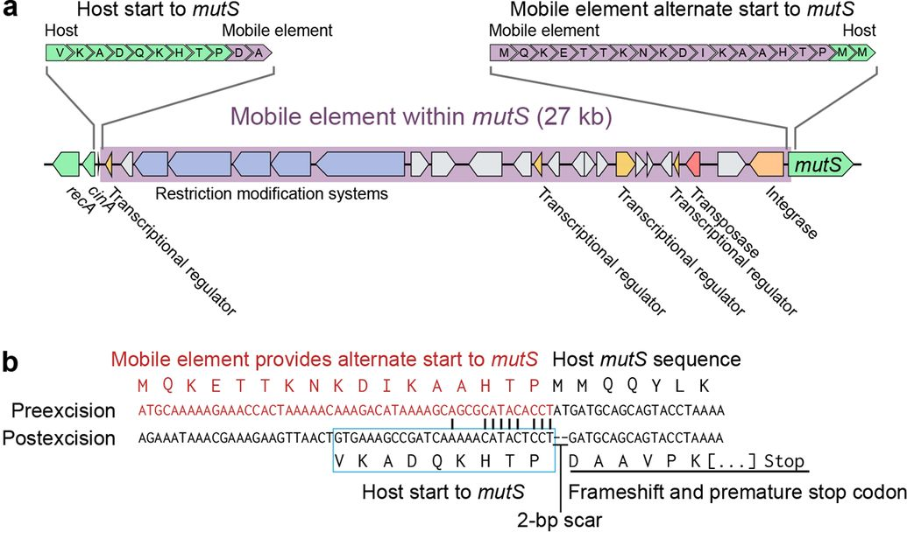
Hypermutating Marine Microbe Vibrio splendidus 12B01
Chu, N., Clarke, S., et al. A Mobile Element in mutS Drives Hypermutation in a Marine Vibrio. mBio, 2017
Notes:
To informatically reconstruct the phylogenetic tree, the genomes of each cell has to be different from each other,
so we need at least one mutation per generation
we used a hypermutating marine microbe, vibrio splendidus 12b01 evolved through selection by Eric Alm’s lab at MIT. This strain has a damaged MutS gene due to the removal of a mobile gene element flanking the MutS gene. The discovery study showed that this strains gets 3-5 snps per cell per generation, on average.

Slide 5
Mutation Rates are Heterogeneous Time
V. splendidus 12B01 – 5 generations 25 samples
Experiment 1
V. splendidus 12B01 – 7 generations 102 samples
Experiment 2
1 SNP
1 SNP
Notes:
Sample info
Non-mutators – heterogeneous in time
Phylogenetic tree is hard
Wanted to see if this occurs in other organisms
---------------------
??? What is the yellow point?

Slide 6
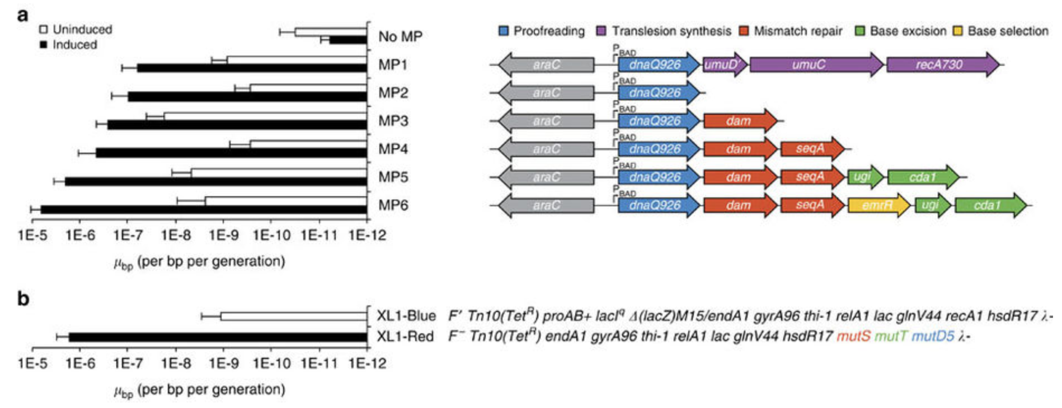
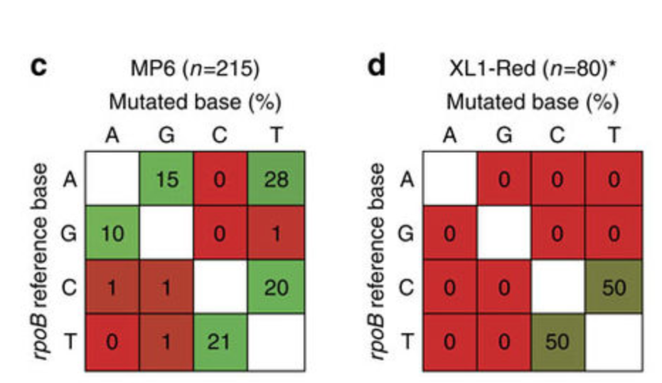
Inducible E. coli Hypermutation System (MP6)
Mutation Spectrums of MP6
Badran, A. H. et al., Development of potent in vivo mutagenesis plasmids with broad mutational spectra, Nat Comms (2015)
Notes:
For this work, I am using a inducible Ecoli hypermutation system (MP) developed by the Broad Institute fellow. Dr. Ahmed Badran. The hypermutation is induced by arabinose that triggers the expression of genes that cause the mutation through:
proof reading,
mismatch repair,
base excision,
and base selection.
Using this system, the hypermutation can be turned on and off depending on the step of the experiment to increase the signal in variant calling. Another benefit of using this system versus other hypermutators that typically use faulty DNA repair system is that it generates a wider mutational spectrum. As you can see in this figure, the MP6 system we are using has a more diverse mutation types compared to the commercially available hypermutant XL1-Red that only produces T-to C mutations.

Slide 7
Mutation Spectrum: V. splendidus vs MP6
V. splendidus 1
V. splendidus 2
MP6 1
MP6 2
Notes:
Broader mutation spectrum

Slide 8
Mutation Rates are AGAIN Heterogeneous Time
MP6 E. coli - 5 generations 31 samples
Experiment 1
MP6 E. coli - 5 generations 28 samples
Experiment 2
3 SNPs
2 SNPs
Notes:
Supported by repeated experiment (lineages)

Slide 9
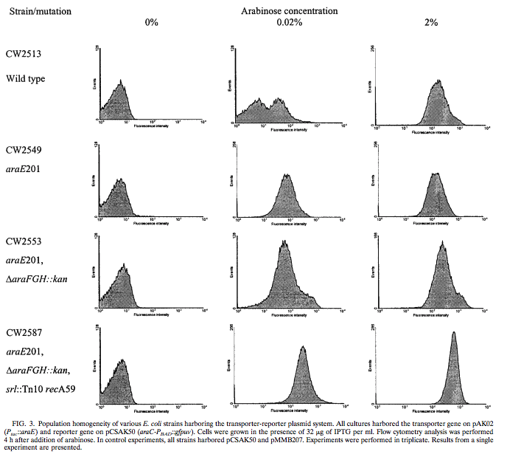
Problem1: Bimodal Expression of Profile of pBAD Sytem
Khlebnikov, A., et al. Regulatable Arabinose-Inducible Gene Expression System with Consistent Control in All Cells of a Culture. Journal of Bacteriology, 2000
Solution: use E. coli S1021 with araE KO

Slide 10
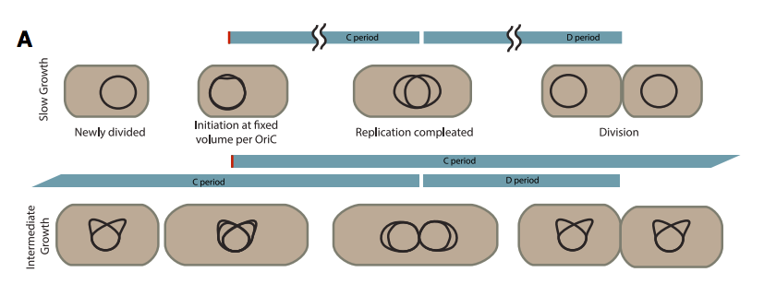
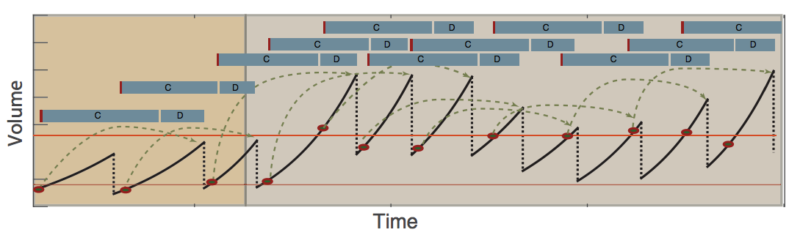
Problem2: Multiple Chromosomes in Log Phase E. coli
Wallden, M., et al. The Synchronization of Replication and Division Cycles in Individual E. coli Cells. Science, 2016
Solution: use slow growth conditions
Notes:
Broader mutation spectrum

Slide 11
DAPI - FACS Counting Chromosomes
S0.05% CAS AA OD:0.929 (MAX)
S0.05% CAS AA OD:0.322
L30C-0.05% CAS AA
Growth condition: M9 minimal media + 0.05% CAS AA + 0.8% Glu @ 30C → division time ~120min

Slide 12
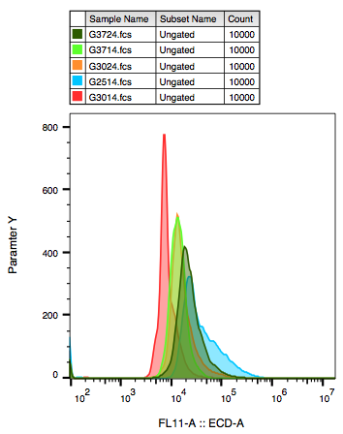
S1021 Chromosome Counts are Low at Pre-Log Phase < 0.1 OD
G: Glucose
37 vs 30: 37C vs 30C
1: Saturated (> 1 OD600)
2: Pre-log (<0.1 OD600)

Slide 13
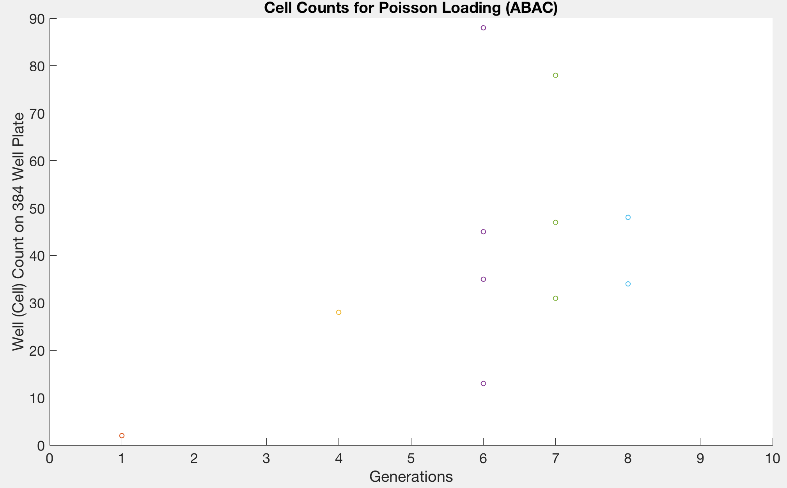
S1021 MP6 Cells Loading Not 2^{x}

Slide 14
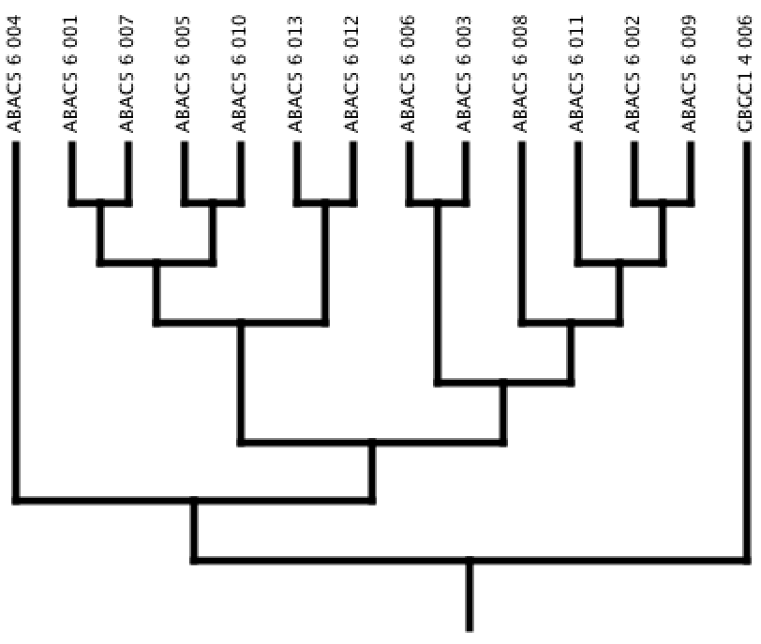
S1021 MP6 Lineages are Not Symmetric

Slide 15

Single Bacteria Growth Video Shows Imperfect Doubling (Unsynchronized)

Slide 16
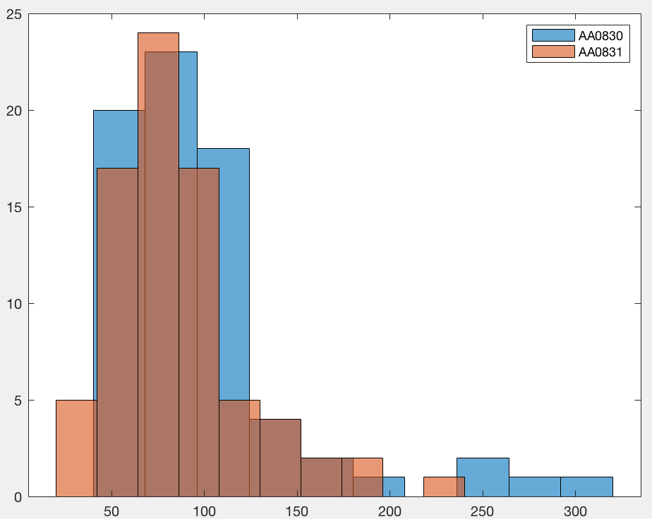
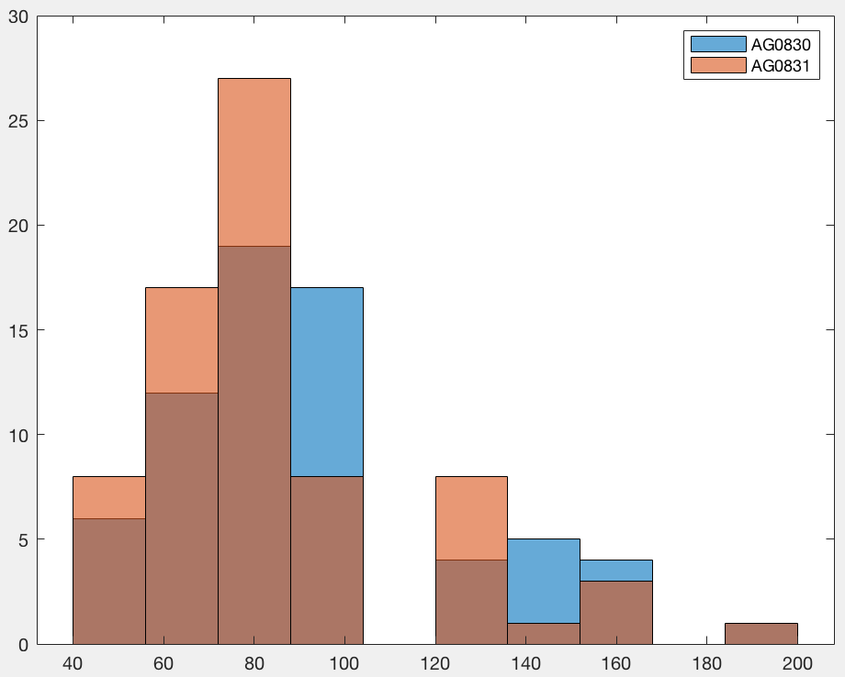
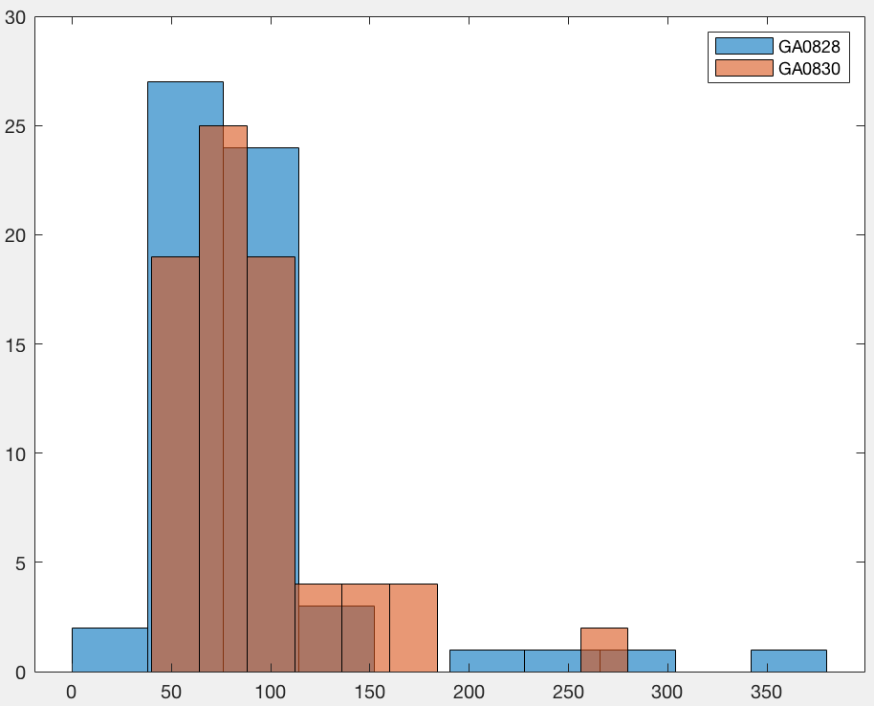
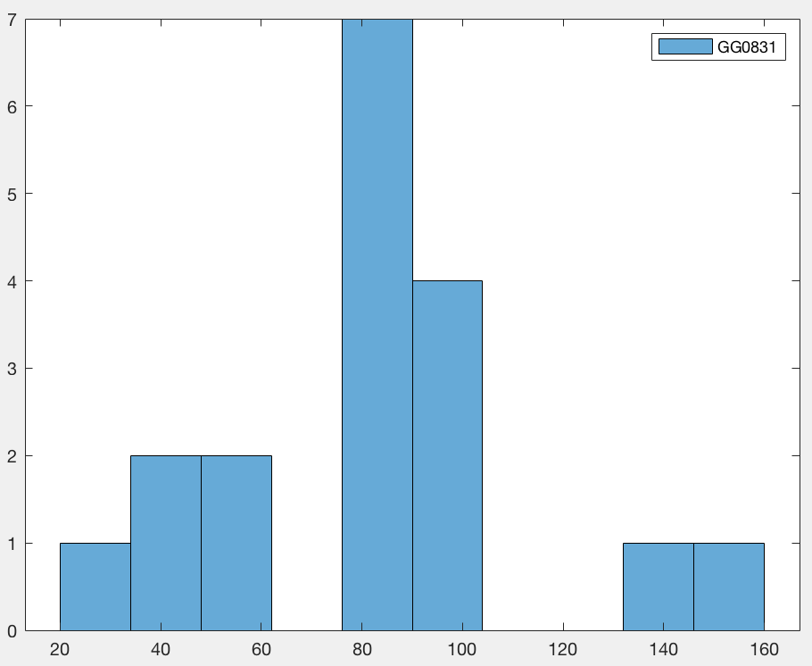
Growth Characteristics S1021
AA Cell Doubling Time Hist
AG Cell Doubling Time Hist
Cell counts
Cell counts
Doubling time (min)
Doubling time (min)
GA Cell Doubling Time Hist
GG Cell Doubling Time Hist
Cell counts
Cell counts
Doubling time (min)
Doubling time (min)

Slide 17
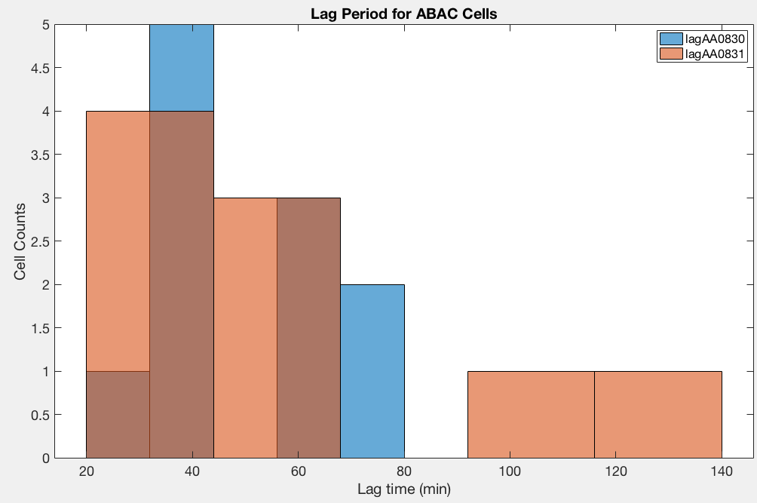
Lag Period May Cause Non-Theortical Cell Counts

Slide 18
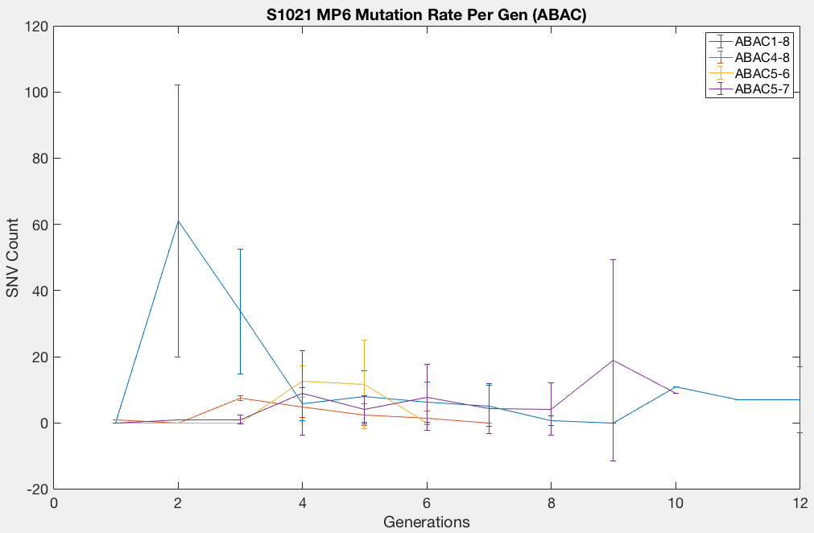
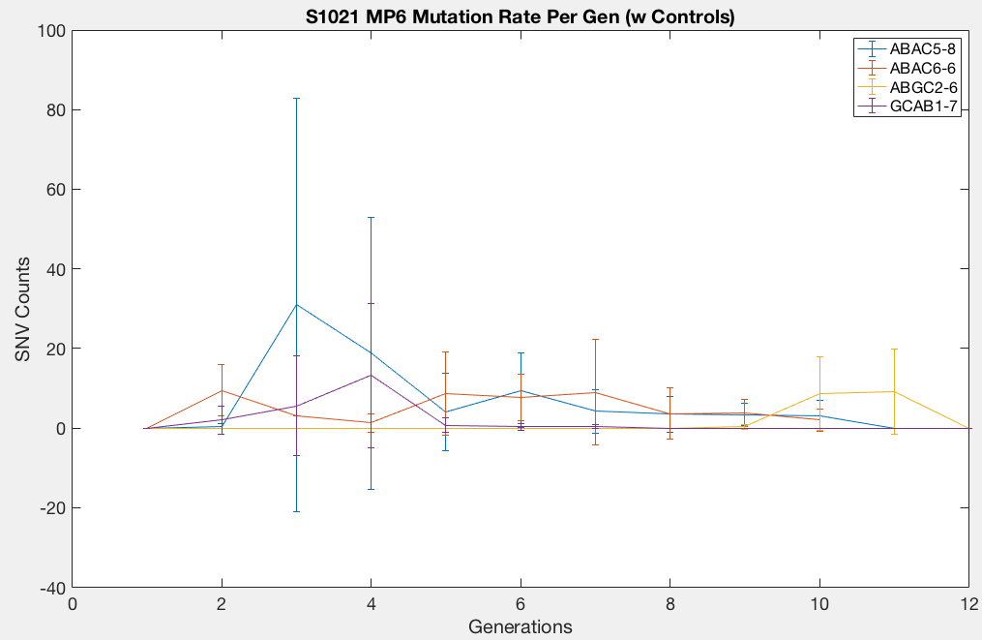
S1021 MP6 Mutation Rate

Slide 19
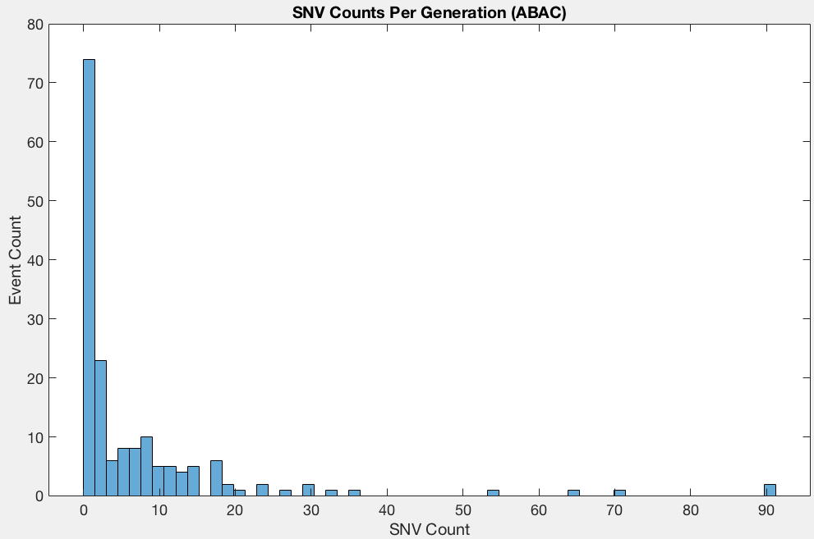
ABAC Mutations are Non-Poissonian in Time (High 0’s)

Slide 20
Early Mutator Effects are Different than Equilibrium Mutators
Avg(%) / GBAC
3.39 / 0.00
9.64 / 2.00
3.84 / 8.00
0.86 / 4.00
5.86 / 2.00

Slide 21
Notes:
https://www.sciencedirect.com/topics/medicine-and-dentistry/mutation-rate

